Slide 1


BUILD AN EVENT MANAGEMENT SYSTEM USING SALESFORCE
Project Based Experiential Learning Program

Slide 2





1. INTRODUCTION :
OVERVIEW :
Event management is the process of creating and maintaining an event. This process spans from the very beginning of planning all the way to post-event strategizing.
At the start, an event manager makes planning decisions, such as the time, location, and theme of their event. During an event, event managers oversee the event live and make sure things run smoothly. After an event, event managers are tasked with reviewing event data, submitting KPI and ROI findings, and staying on the ball for any post-event offerings.
All different branches of planning go into event management, including various types of sourcing, designing, regulation checks, and on-site management. In event management, you could be in the process of creating a conference, a product launch, an internal sales kick-off, or even a wedding. Really, any event that requires considerable planning and execution is event management.

Slide 3
Project Description
The project aim is to provide real-time knowledge for all the students who have basic knowledge of Salesforce and Looking for a real-time project. This project will also help to those professionals who are in cross -technology and wanted to switch to Salesforce with the help of this project they will gain knowledge and can include into their resume as well.
What you'll learn
Real Time Salesforce Project
Object & Relationship in Salesforce
Create Salesforce Org

Slide 4
PURPOSE:
Identify your target audience and craft a message that resonate with campaign. Monitor them and setup a system to measure the success of your performance and make necessary adjustments along the way. Design and plan a memorable event and coordinate the day of the event. Evaluate your events performance and power future events. Resolving a location for an event. Selecting an overall event theme and developing invitations. Organizational skills and unbridled creativity and dedication to client service.

Slide 5
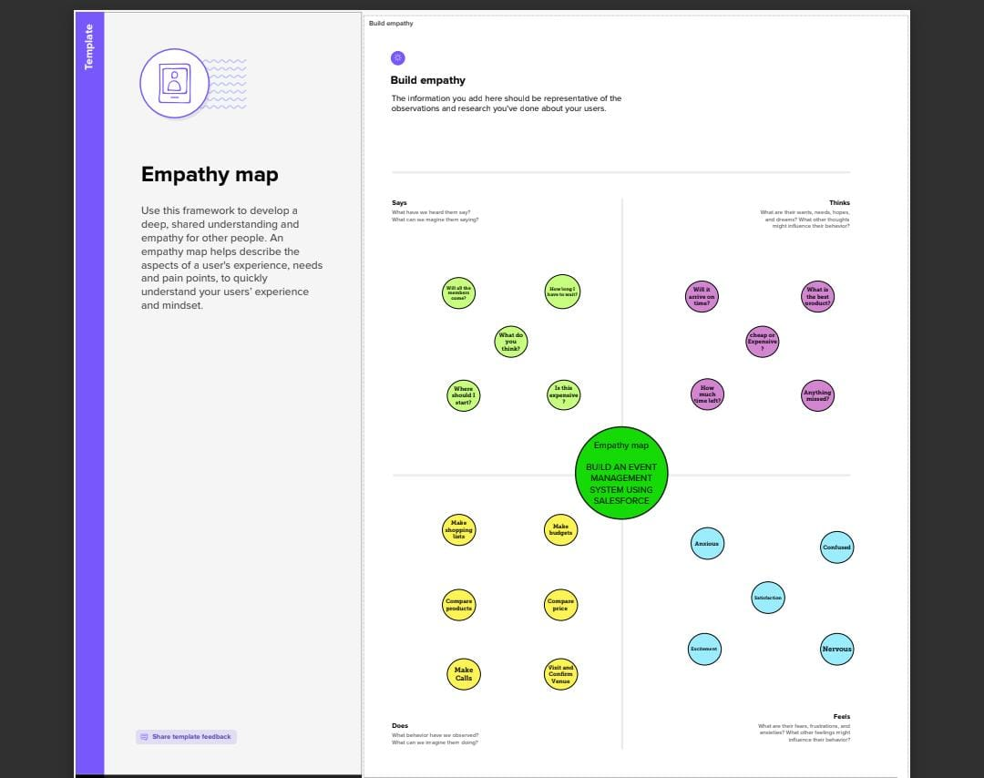
2.PROBLEM DEFINITION & DESIGN THINKING
2.1 Empathy Map

Slide 6
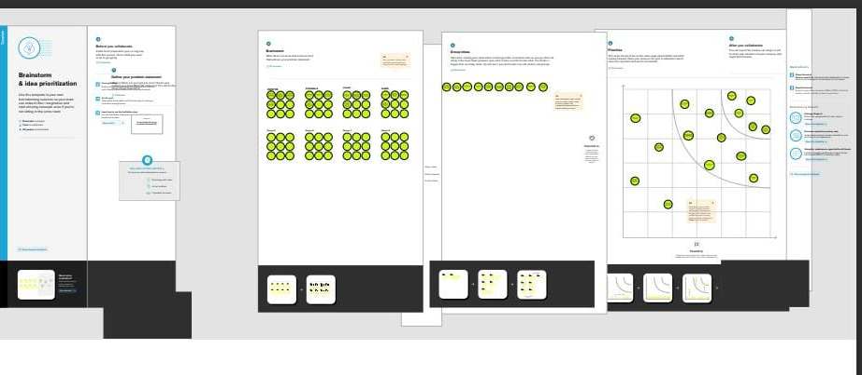
2.2 Ideation & Brainstorming Map

Slide 7
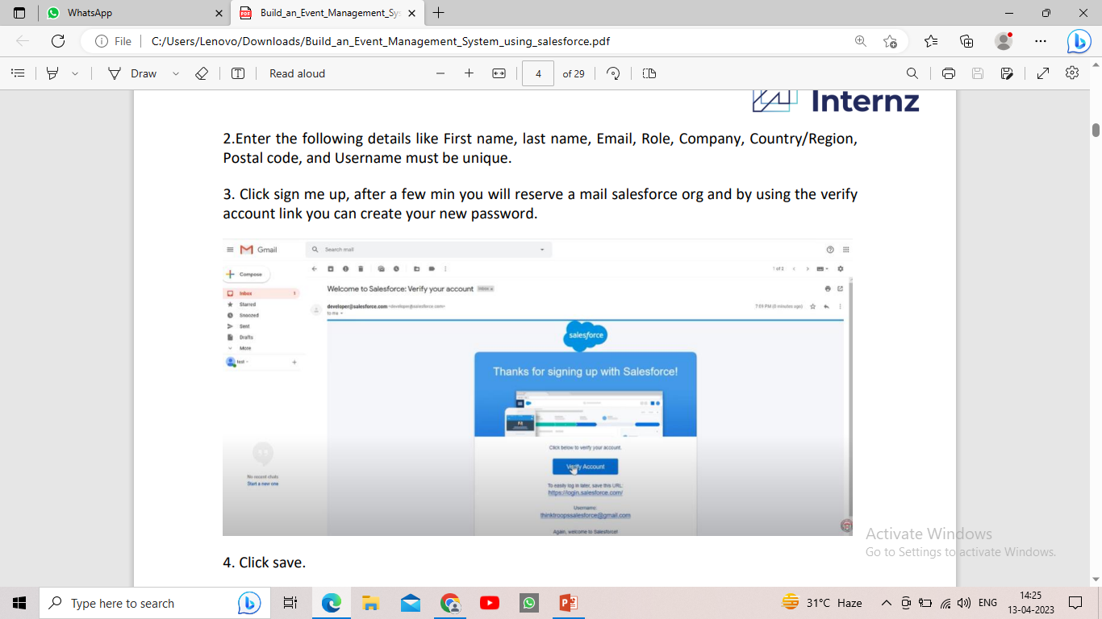
3.2 Activity & Screenshot Creating Developer Account
Using this https://developer.salesforce.com/ link we signup the salesforce platform and finally we get the verification mail that shown in the above figure.

Slide 8
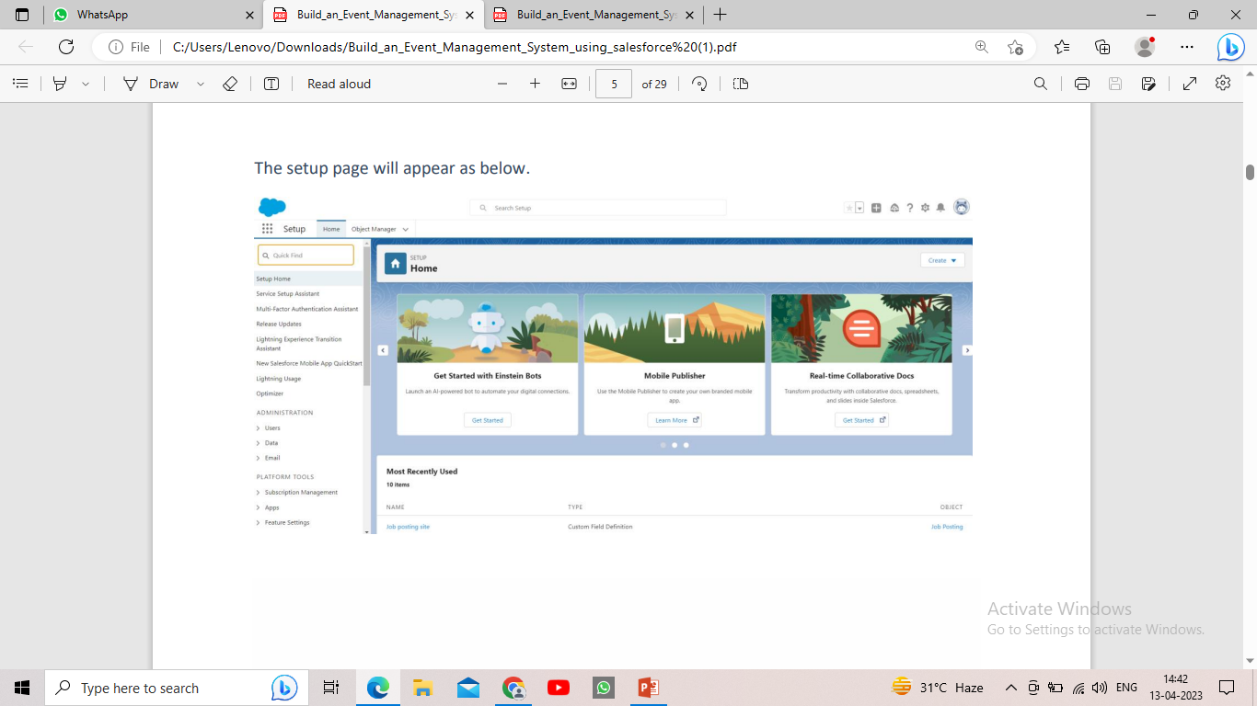
Salesforce Login:
https://login.salesforce.com/ we used this link to login the salesforce platform. This link asked our username and password only.

Slide 9
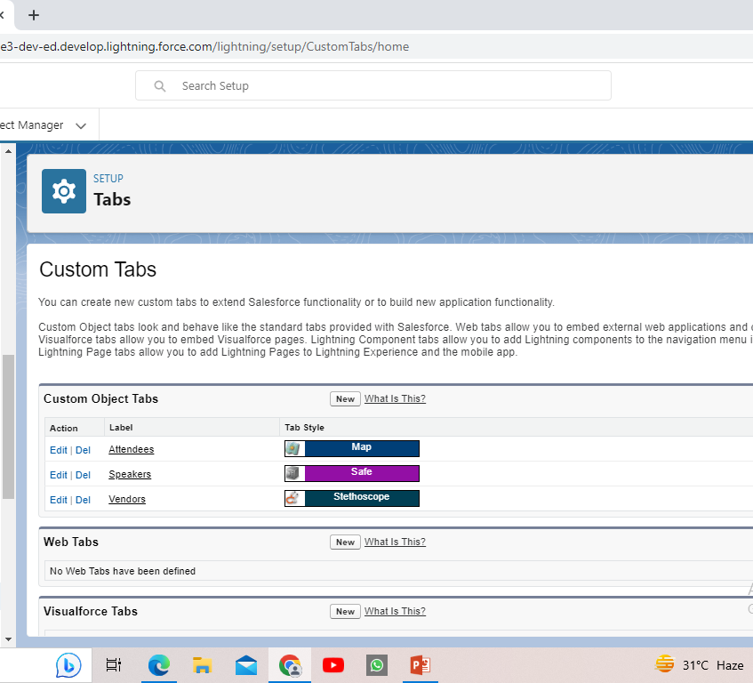
Object :
for this event management project we created 3 objects. They are attendees object , speaker object and vendors object.

Slide 10
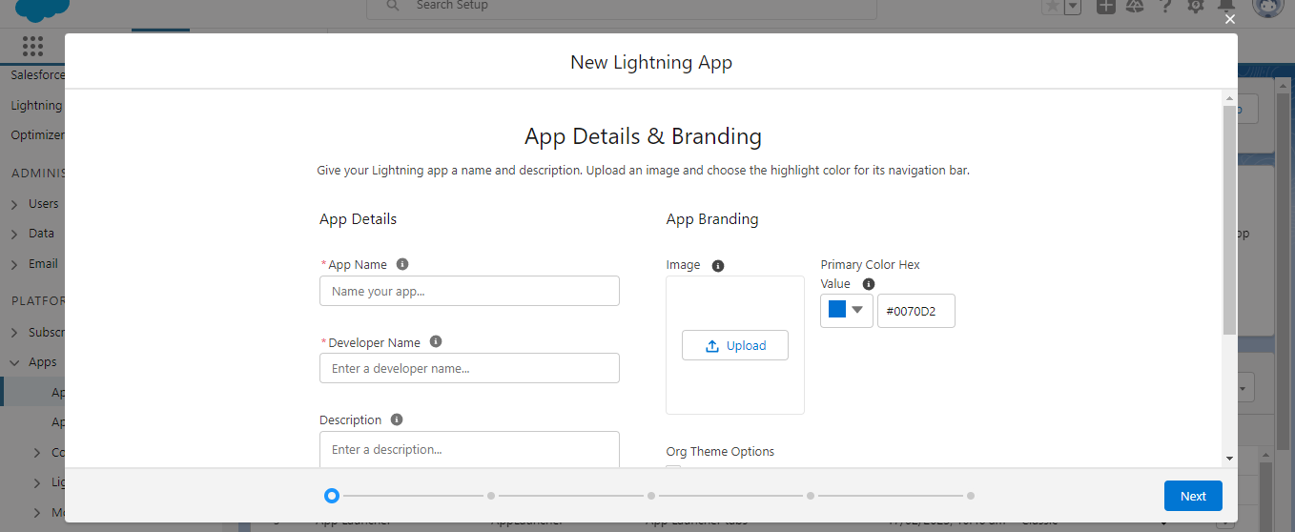
Lightning App:
Under this title we created the Lightning App using New Lightning App. The created new lightning app will shown in the figure.

Slide 11
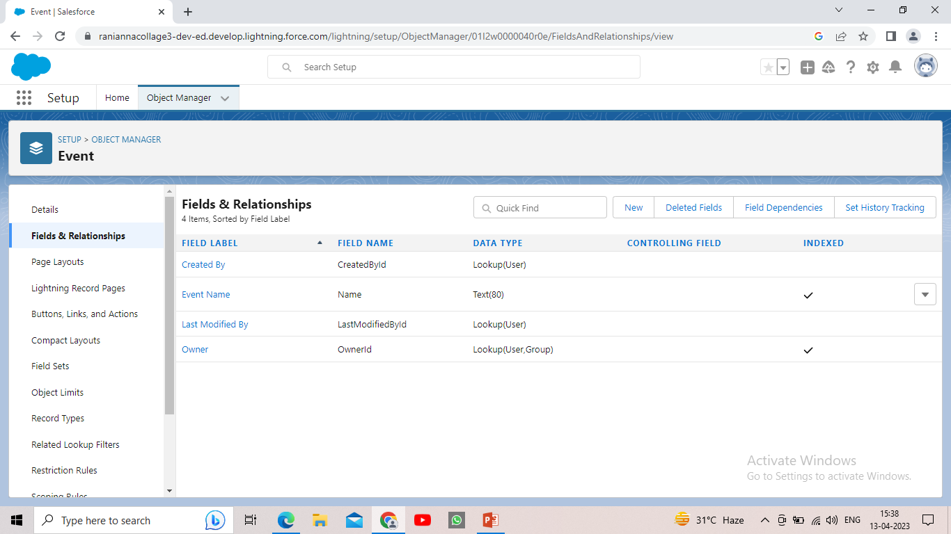
Field and Relationship
Relationship are created custom relationship field on an object manager. This is done so that when users view records, they can also see access related data.

Slide 12
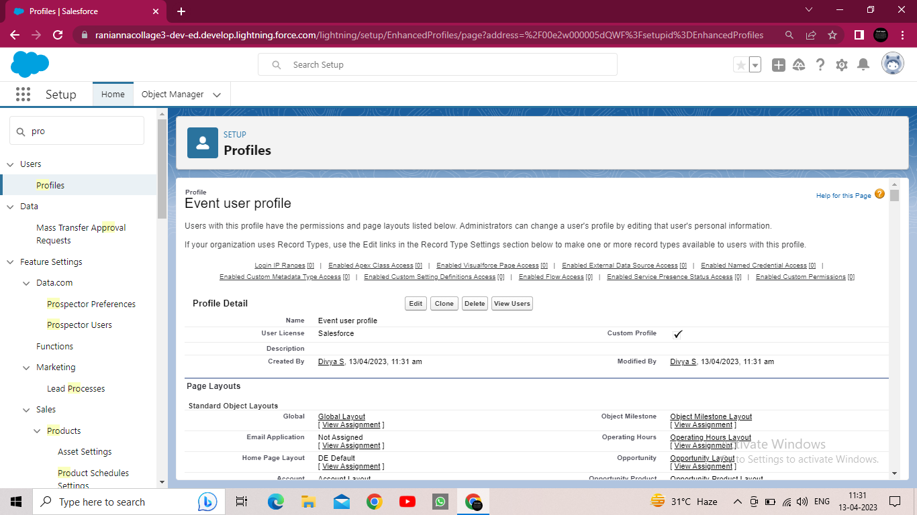
Profiles:
We created the event management profile. In custom object permission we give view all access permission and the event user profile.

Slide 13
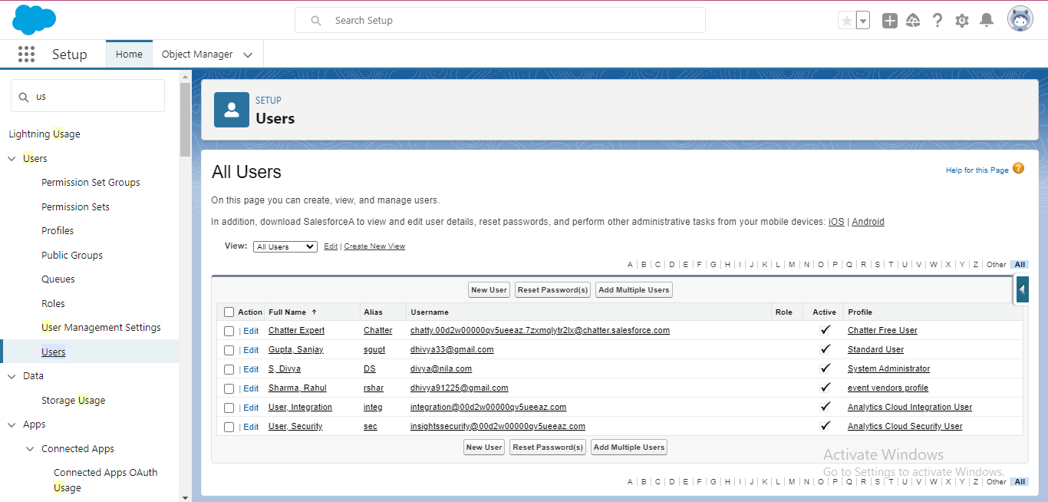
Users
We created the two users like Sanjay and Rahul .

Slide 14
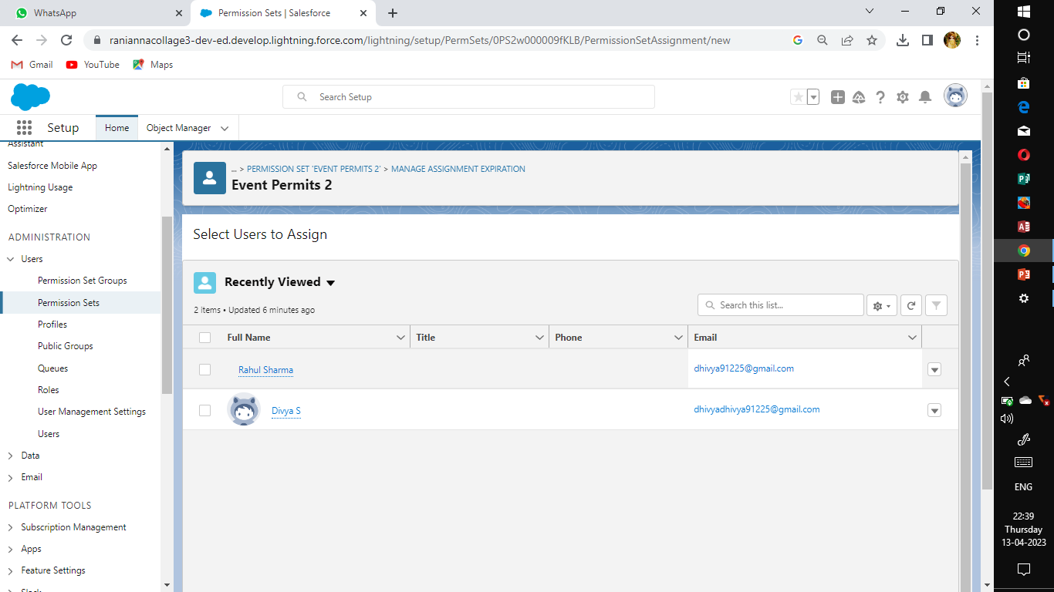
Permission sets:
In this activity we create the two permission sets like event permits and vendors permits.

Slide 15
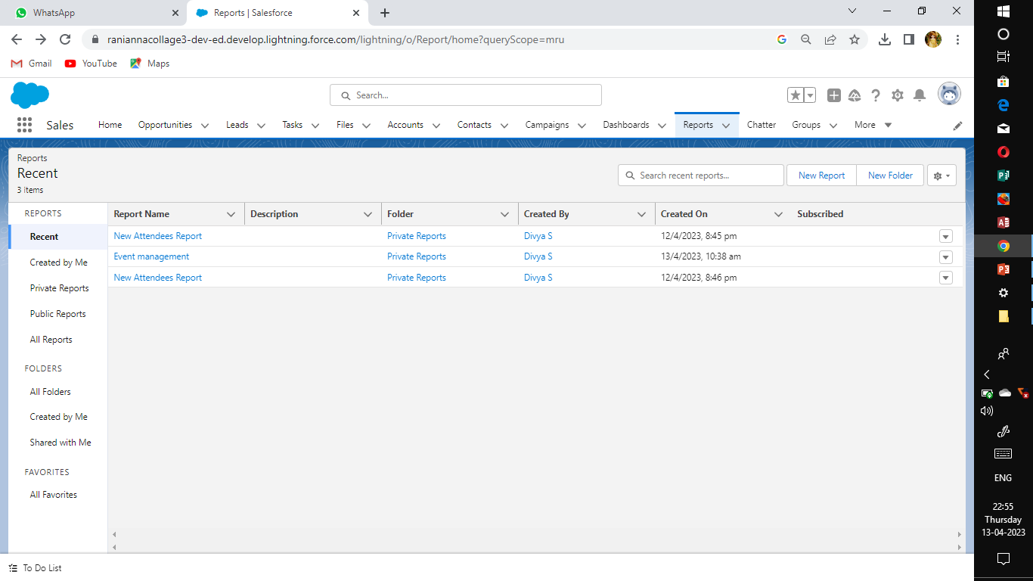
Reports:
From the report tab we create report type as event with attendees and event management repot. They are checked the run button.

Slide 16
4. Trailhead Profile Public URL
Team lead - https://trailblazer.me/id/divys38
Team Member 1 - https://trailblazer.me/id/gomas7
Team Member 2 - https://trailblazer.me/id/indhr7
Team Member 3 - https://trailblazer.me/id/sasia17

Slide 17
Advantages & Disadvantages:
There are several advantages and disadvantages of using an Event Planner management service. These include: – Experience requirements, – Cost, – Loose coupling and – Stress. Experience is one of the most important factors. – Loose coupling is a disadvantage: a manager may not be aware of the costs and risks of the job.
Table of Contents
Experience requirements
Cost
Stress
Loose coupling
Conclusion

Slide 18
Experience requirements
An event management career involves organizing events for a variety of different people. The work involves ensuring that everything runs smoothly and successfully. It involves establishing order from chaos, and often involves working on a tight schedule. The job also requires a certain amount of creativity. If you are able to make people happy during your event, then you’ve done your job well. This type of work also requires you to solve many different problems each day, so you’ll never get bored and Why Hire an Event Planner.
The experience requirements for event management jobs vary, but most professional positions require a bachelor’s degree. Coursework usually includes general education classes that lay the foundation for event management and customer relations. Some courses will focus on meeting technology, event evaluation, and trend analysis. Some degree programs will also require an internship where you’ll gain hands-on experience planning events.

Slide 19
Certification in event management often involves taking a comprehensive exam. In order to become certified, you’ll need a minimum of three years of experience. In addition, you’ll have to complete an online learning program. After completing the program, you’ll be ready to take the DES event certification exam. The exam will include a number of questions related to business management. The certification will ensure that you have a high level of expertise in event marketing.

Slide 20
Cost
The cost of event management software varies Negotiating Contracts with Event Organizers, depending on the feature set and its capabilities. Some are designed to manage an entire event lifecycle, while others only handle certain aspects. End-to-end solutions, which manage the planning, event, and post-event stages, are ideal for large events. Others are tailored for small projects or users with specific needs. The price for each solution varies based on its feature set, which should be carefully considered.
Event managers may charge a fixed fee for managing events, but they can also pass on certain costs, depending on the event’s location and on-site support. These costs are typically not disclosed, but they can add up to the final cost of event management. It’s therefore important to understand these costs, as they can significantly increase the overall cost.
Event management software can automate many of the manual processes related to an event. This can reduce the risk of losing files and time-consuming manual processes.

Slide 21
Stress
Event management offers job flexibility and a varied work environment. In addition to meeting clients in a wide range of settings, event managers can also travel, allowing them to build relationships with different types of customers. Additionally, working with various types of groups will improve their social and communication skills. They can also gain valuable experience and learn new techniques.
Event management can also be stressful. The pressure to meet deadlines and ensure that everything is going well can lead to mistakes and distractions. As such, many people who get into this field leave the industry after a couple of years. Event management is not for everyone. It requires travel and can be extremely tiring after a while. People who suffer from motion sickness or are easily distracted may want to avoid a career in event management.

Slide 22
There are many different kinds of 5 Skills of Great Corporate Event Planners event management software available. Some offer a wide range of features and can be quite costly. You should choose the best software according to your needs. Some offer features that will benefit your company, while others will only be useful for bigger events. Loose coupling Event management can be tricky. In event-driven systems, components publish and subscribe to events in order to communicate with each other. This can be advantageous in a fan-in and fan-out scenario where multiple components need to communicate with each other in real time. It also allows for fault tolerance. It’s important to understand the concept of loose coupling. Using this approach allows for faster deployment and greater flexibility. It is also associated with better business performance. Generally, loose coupling enables organizations to adapt and grow without causing disruptions to other processes. For example, if a customer wants to change the name of an email message, they can do so without impacting other emails.

Slide 23
Conclusion Loose coupling has many applications. Its benefits go beyond simple event management. It can help companies improve their workflow by streamlining the process of organizing and executing events. It also makes the implementation of a service more reliable. You can learn a lot more about event management from the experts at Mavrix.

Slide 24
Future Prospects in Event Management- Nowadays, there is a requirement for an event manager in almost every field like in corporate sector, hotel industry, tourism, fashion industry, film and media industries, social events etc. the talented youngsters can either work as a professional or set up his/her own business. Professionals in this field also get the opportunity to showcase their talent at international levels where delegates from our country participate in cultural festivals and exchange programs, trade shows, conferences, exhibitions, corporate events and so on. A successful event manager can earn in lakhs and cores. So, the demand for creative and talented event managers is never ending.

Slide 25
THANKING YOU…

